Slide 1
Technical agreement
NUSEED-FAUBA 2022
Brassica carinata growth
Updated February 2023
Teamwork: Daniel Miralles, Gonzalo Rivelli, Carina Ibañez, Maximiliano Rodriguez, Gabriela Abeledo, Déborah Rondanini
miralles@agro.uba.ar, rondanin@agro.uba.ar

Slide 2
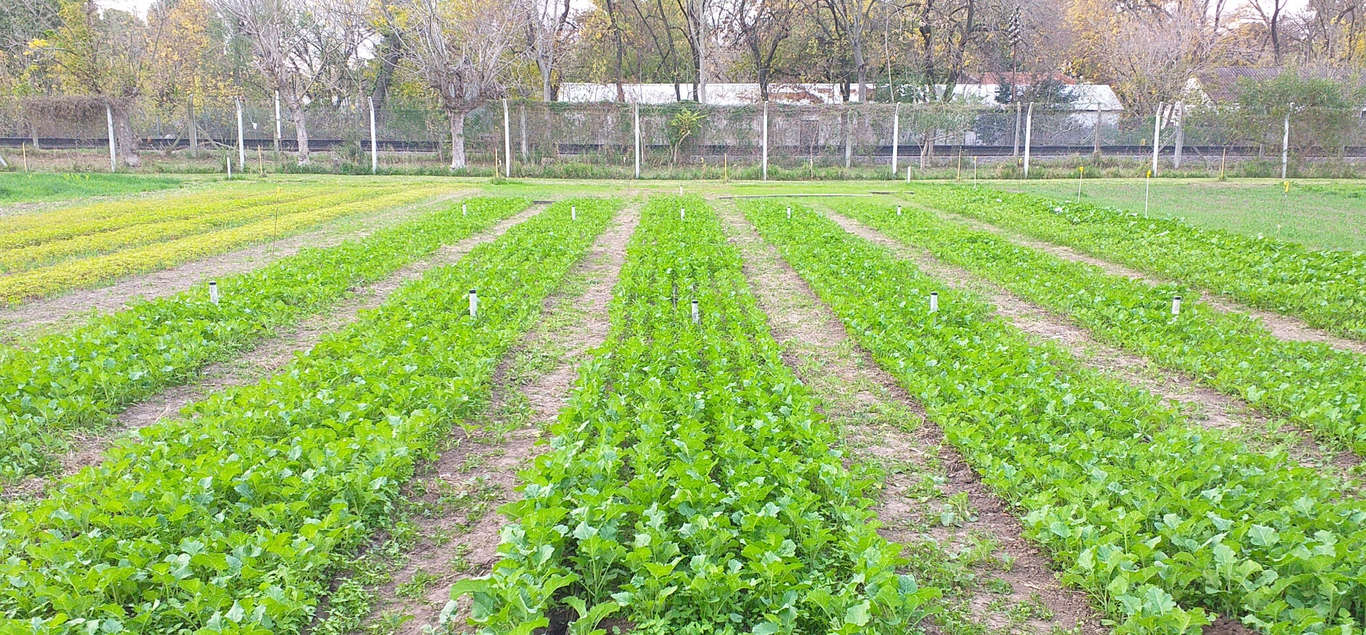
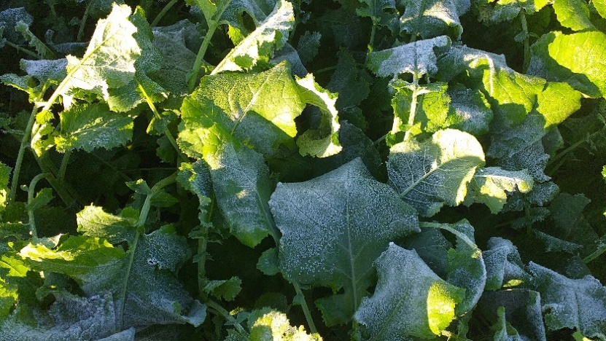
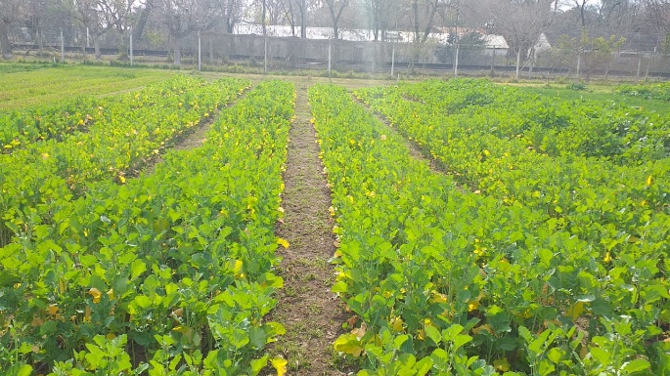
Experimental
Experiments at the School of Agronomy, University of Buenos Aires (34°36’S 58°26’W)
Typical Argiudoll with a strong clayey horizon (Bt) at 40 cm depth. Same plot than in 2021
Nujet 400 (hybrid) and Avanza 641 (OP variety) with 5 replicates
Sowing date: April 6, 2022 (78 days earlier than 2021) Planting rate: 100 plants/m2
Husbandry: drip irrigation and fertilization (up to 100 kg N available/ha), cletodim and preventive fungicide in V6.
Foliar S fertilizer (June 28, 76 DAE) to reverse foliar cold damage. Insecticides for aphids in reproductive stages.
A very dry year (but irrigated). More problems with weeds, early frosts, and aphids than in 2021
May 11, 2022
(29 DAE)
May 31, 2022 (49 DAE)
1.2 m deep probe tubes
7 rows (0.2 m apart) x 10 m long
Avanza
June 29, 2022 (78 DAE)
7 rows (0.2 m apart) x 12 m long
Nujet
Avanza ISR 80%
yellowing
Nujet ISR 90%

Slide 3
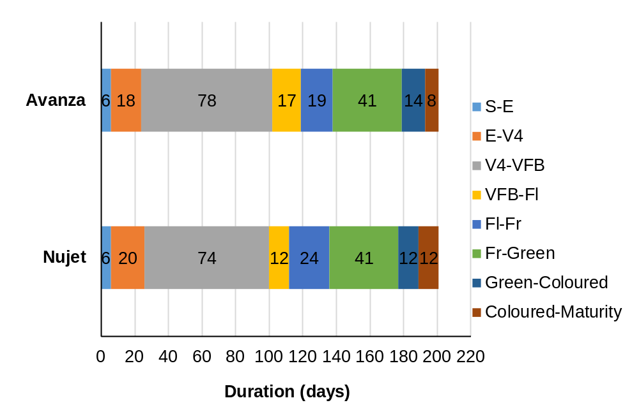
Crop phenology
-Similar crop phenology in both genotypes
-Beginning of flowering in late July-early August (frost risk, low photothermal quotient)
-Maturity in late October (early planting for summer crop)
DAS: days after sowing
2022
Sowing date: April, 6
Emergence: April, 12 (6 DAS)
Visible floral bud (VFB):
Nujet: July, 15 (100 DAS)
Avanza: July, 17 (102 DAS)
First flowering (FL):
Nujet: July, 27 (112 DAS)
Avanza: Aug, 3 (119 DAS)
Maturity:
Nujet: Oct, 24 (201 DAS)
Avanza: Oct, 24 (201 DAS)
2021
Sowing date: June, 23
Emergence: July, 3 (10 DAS)
Visible floral bud (VFB):
Nujet: Sept, 8 (77 DAS)
Avanza: Sept, 10 (79 DAS)
First flowering (FL):
Nujet: Sept, 19 (88 DAS)
Avanza: Sept, 17 (86 DAS)
Maturity:
Nujet: Nov, 30 (160 DAS)
Avanza: Nov, 30 (160 DAS)
2022: Days from sowing to flowering: 112 days Nujet, 119 days Avanza. Whole crop cycle: 201 days after sowing (around 57% of cycle for pre-flowering and 43% for post-flowering)
2021: Days from sowing to flowering: 88 days Nujet, 86 days Avanza. Whole crop cycle: 160 days after sowing (around 55% of cycle for pre-flowering and 45% for post-flowering)

Slide 4
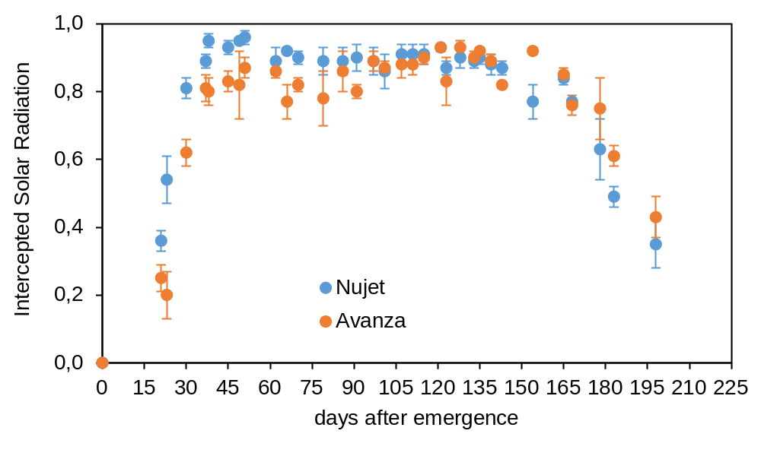
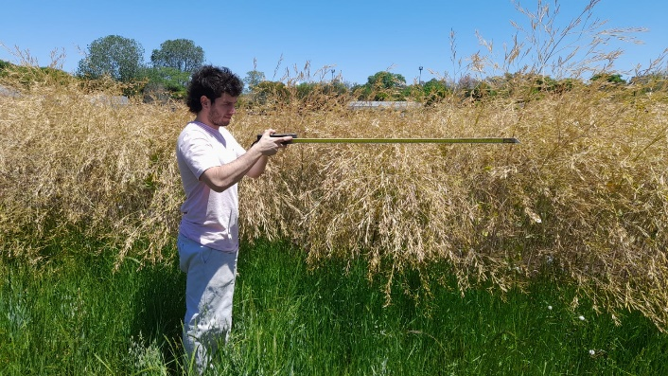
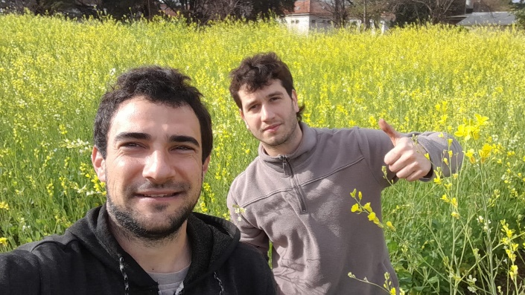
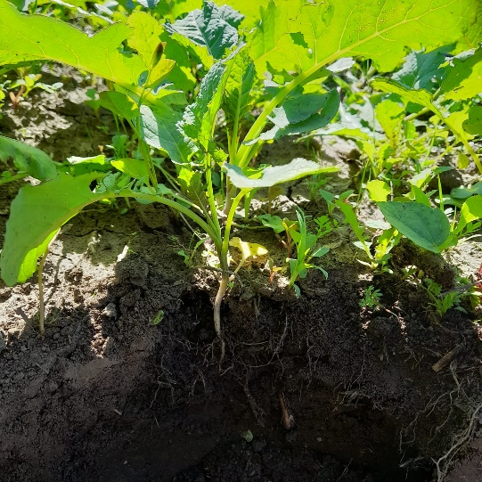

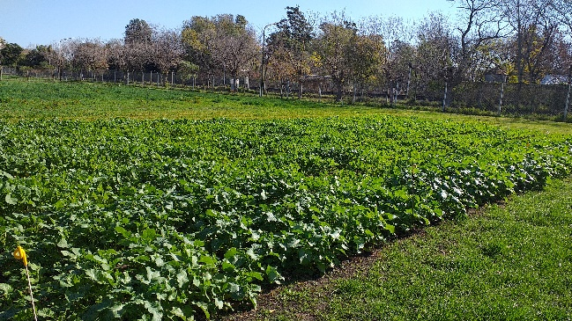
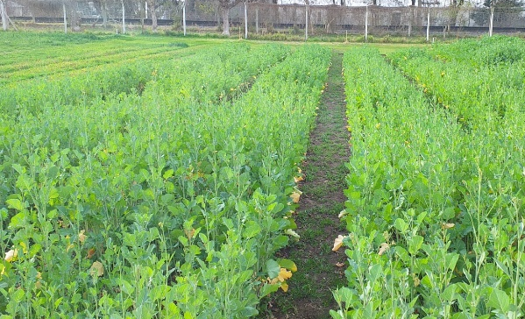
Canopy light capture
-Quick soil coverage (from 15 to 40 DAE) in mid-April to mid-May
-Light interception efficiency (>90%) by late May for Nujet but Avanza yet in mid July
-Leaf yellowing at late June (low temp +dry soil?)
-Similar crop phenology for both genotypes
But different plant growth
Nujet > Avanza
Sowing date: April 6, 2022
Emergence: April 12
Rosette (V4)
Nujet: May 2; Avanza: April 30
Visible floral bud: June 15-17
First Flowering
Nujet: July 27 (106 DAE)
Avanza: Aug 8 (118 DAE)
Maturity: Oct 24-26 (195-197 DAE)
Oct 27, 2022 (198 DAE)
Aug 15, 2022 (125 DAE)
May 11, 2022 (29 DAE)
May 31, 2022 (49 DAE)
July 11, 2022 (90 DAE)
Avanza ISR 90%
Avanza ISR 60%
Avanza ISR 80%
ISR <40%
Nujet ISR 95%
May 4 (22 DAE)
Nujet ISR 90%
Nujet ISR 80%

Slide 5
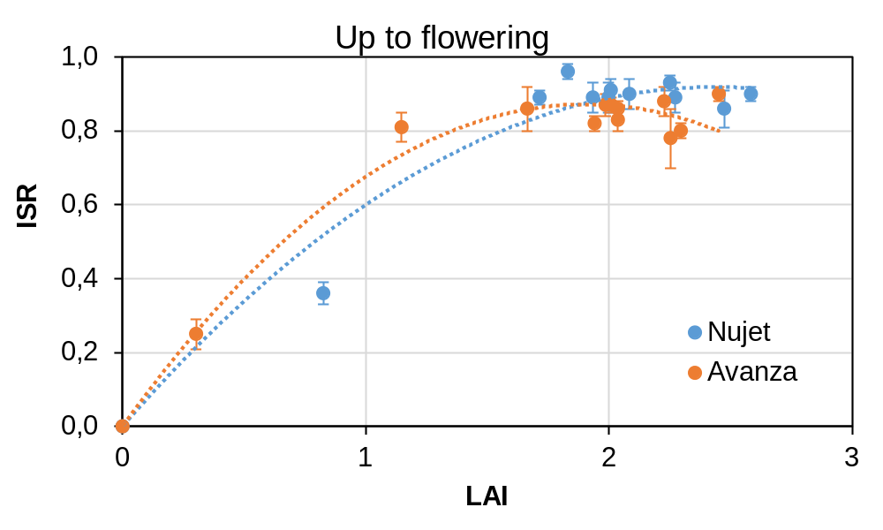
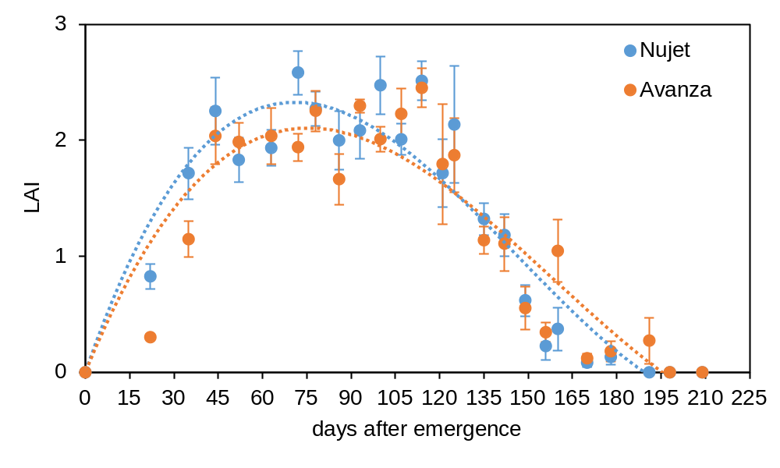
Leaf area index and intercepted solar radiaton
-Quick initial leaf growth (up to 45 DAE)
-then stabilizes around LAI=2-2.5
-quick leaf senescence after flowering
-Nujet: Intercepted solar radiation (ISR) >95% at LAI=2.5
(more data points than 2021)
-Avanza: poor leaf growth, ISR around 85% at LAI=2
-Maximum light capture efficiency (>95% ISR) with LAI = 2.5-3 is typical for Brassicas (and other broadleaf crops)

Slide 6
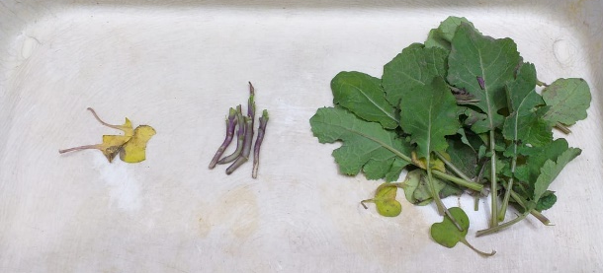
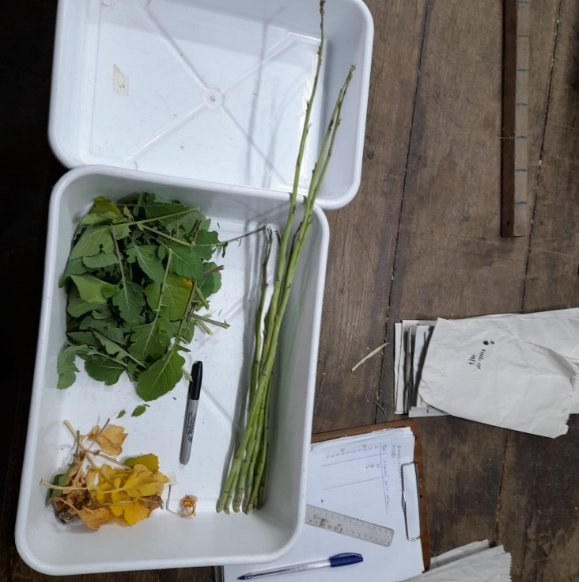
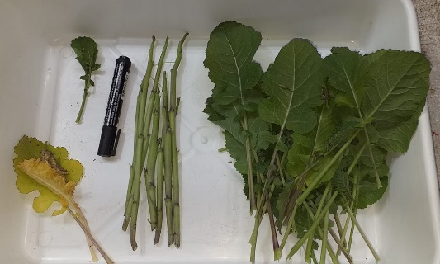
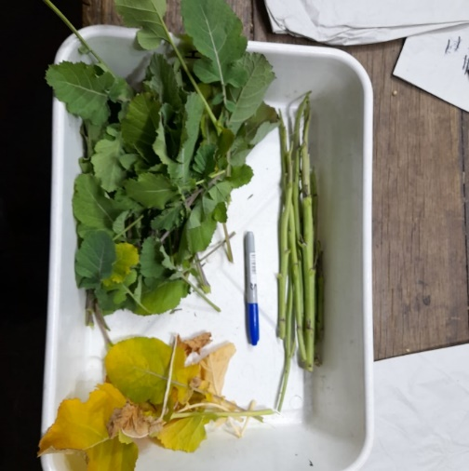
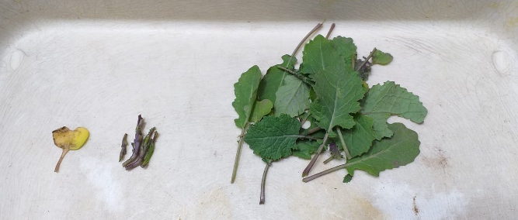
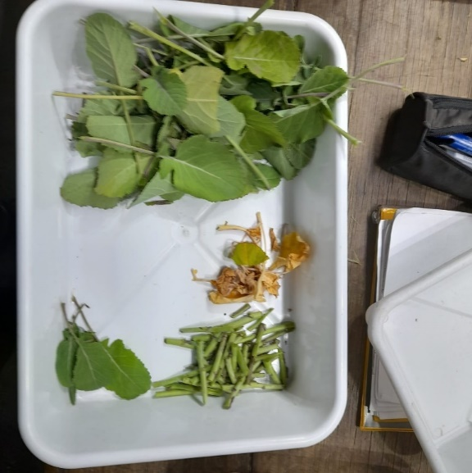
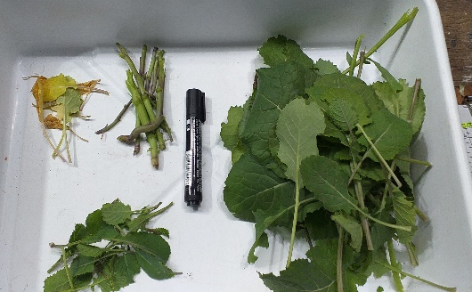
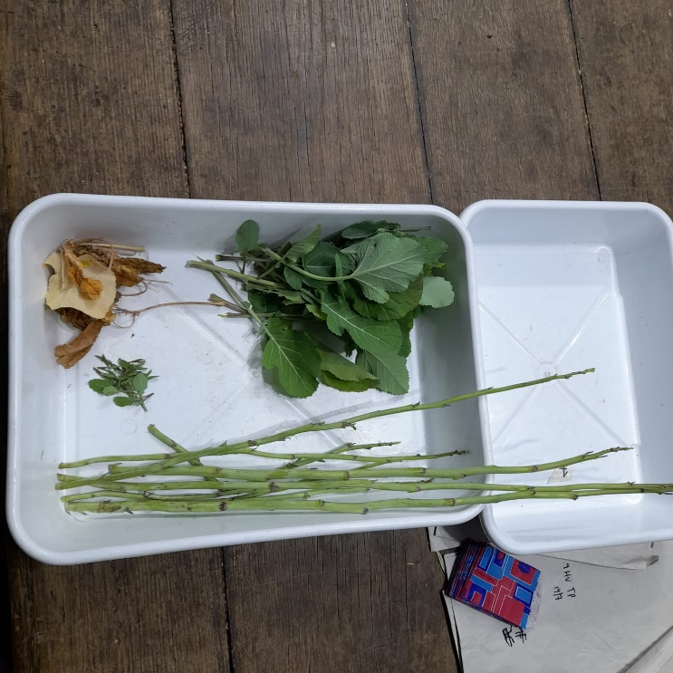
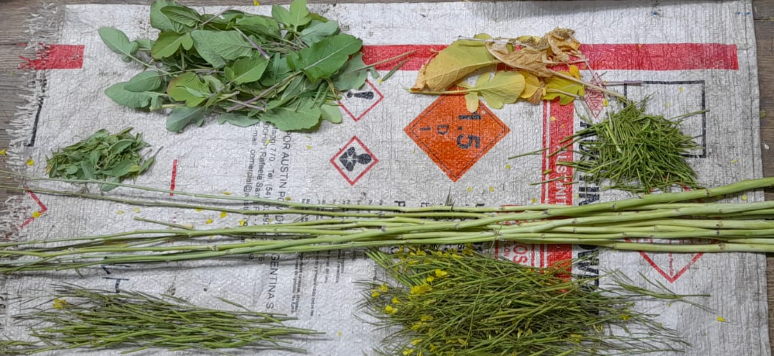
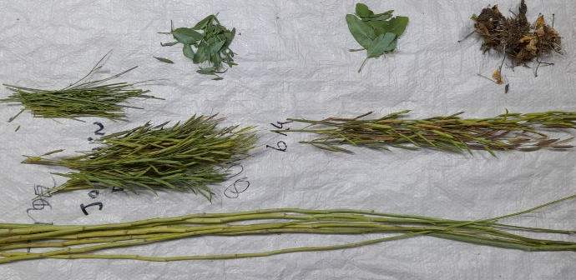
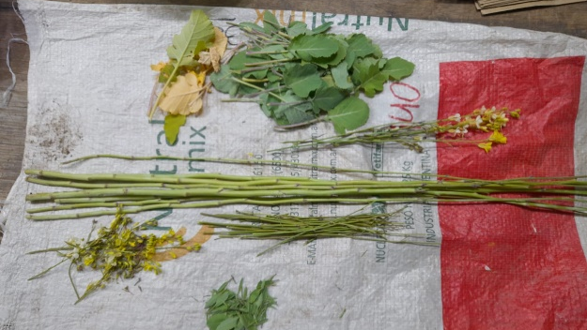
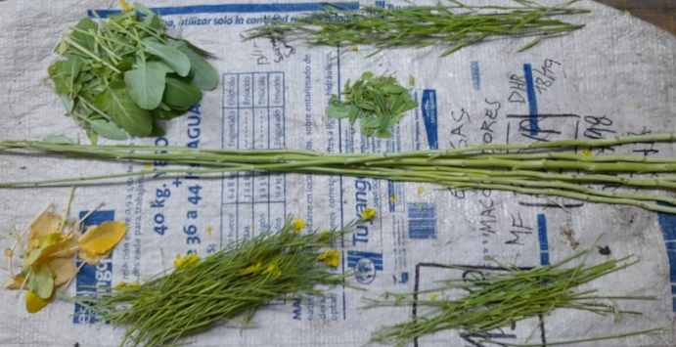
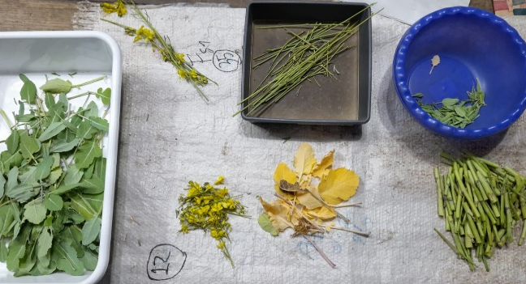
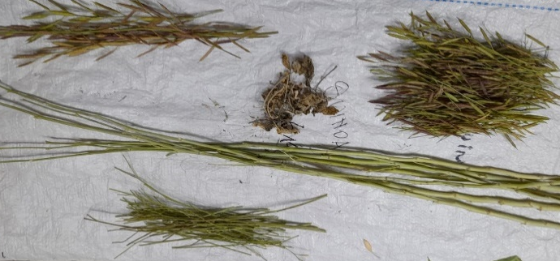
Aerial biomass growth
-Nujet 400 seems to produce more vegetative biomass
-Early leaf yellowing (frost?)
Nujet June 3 (52 DAE)
Nujet June 23 (72 DAE)
Nujet July 14 (93 DAE)
Nujet May 4 (22 DAE)
Avanza May 4 (22 DAE)
Avanza June 3 (52 DAE)
Avanza June 23 (72 DAE)
Avanza July 14 (93 DAE)
Nujet Aug 8 (118 DAE)
Nujet Sept 1 (142 DAE)
Nujet Oct 7 (178 DAE)
Avanza Aug 8 (118 DAE)
Avanza Sept 1 (142 DAE)
Avanza Oct 7 (178 DAE)

Slide 7
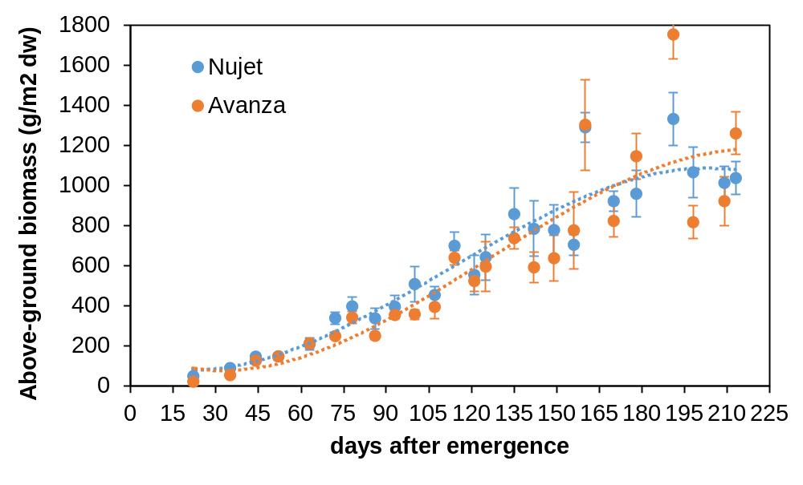
Aerial biomass growth
Aerial biomass at flowering | Kg/ha DW
Nujet (106 DAE) | 4530 ± 410
Avanza (118 DAE) | 6390 ± 370
Aerial biomass at final harvest (213 DAE) | Kg/ha DW
Nujet | 10370 ± 810
Avanza | 12600 ± 1060
-Typical sigmoid pattern
-Around 40-50% of total biomass grows until flowering
(in 2021 sowing late in June only 1/3 of biomass at flowering, reaching 3100-3700 kg/ha)
-Both genotypes exceeded 10 ton/ha of total biomass at harvest
(in 2021 they got 9-10 ton/ha)

Slide 8
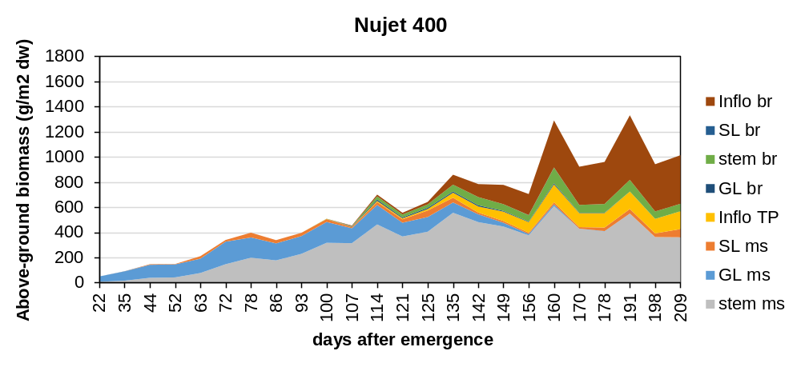
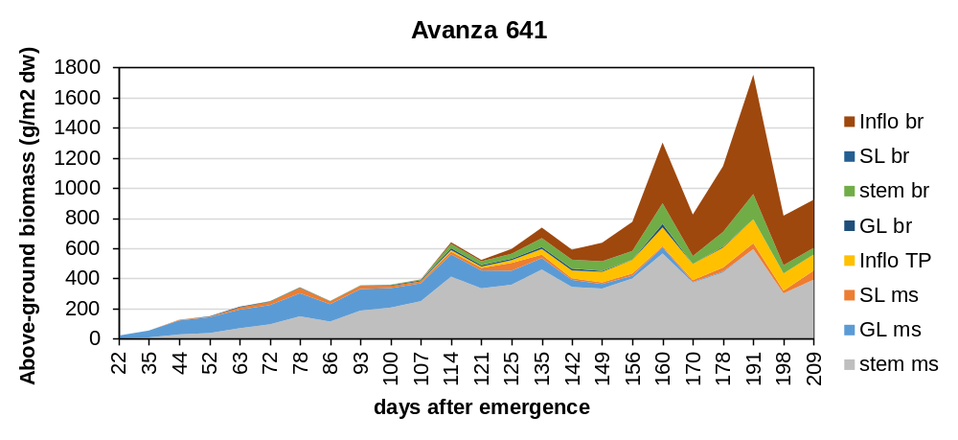
Biomass allocation
ms: main stem
br: branches
-Early leaf senescence since mid June (from 60 DAE)
At maturity:
-Main stem retains 35-40% of total biomass
-A lot of biomass is allocated in the inflorescences of branches (35-38%)
Inflo br
Stem br
Senesced leaf ms
Inflo ms
Green leaf ms
Stem ms
At maturity (209 DAE) | Nujet | Avanza
Stem ms | 36 % | 42 %
Inflo ms | 14 % | 11 %
Inflo br | 38 % | 35 %
Inflo br
Stem br
Inflo ms
In 2021 (sowing late in June) a similar value of biomass was allocated in the main stem (35%) but more was in the inflorescences of branches (45%)
Senesced leaf ms
Green leaf ms
Stem ms

Slide 9
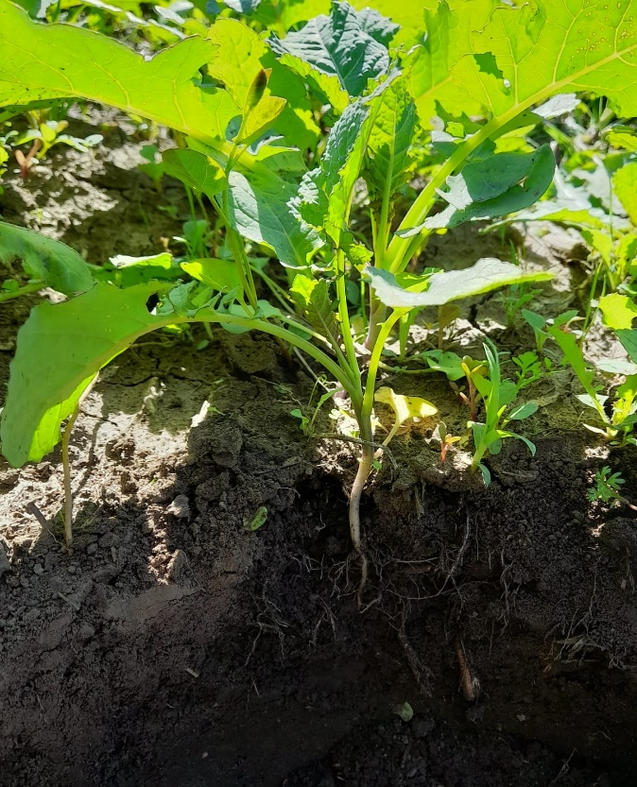
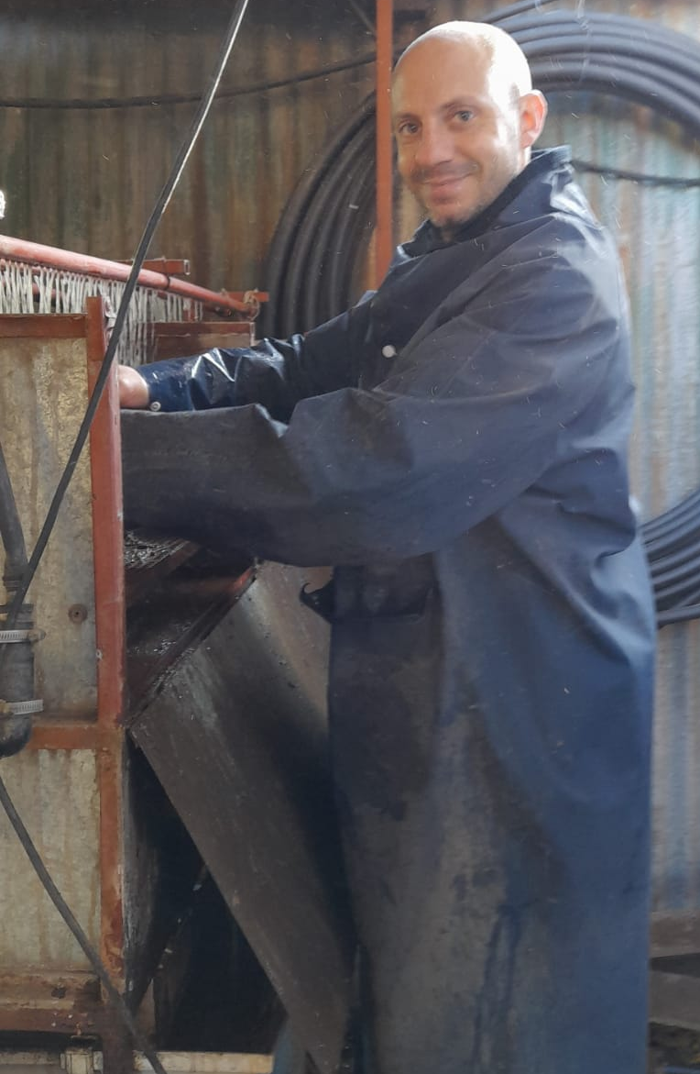
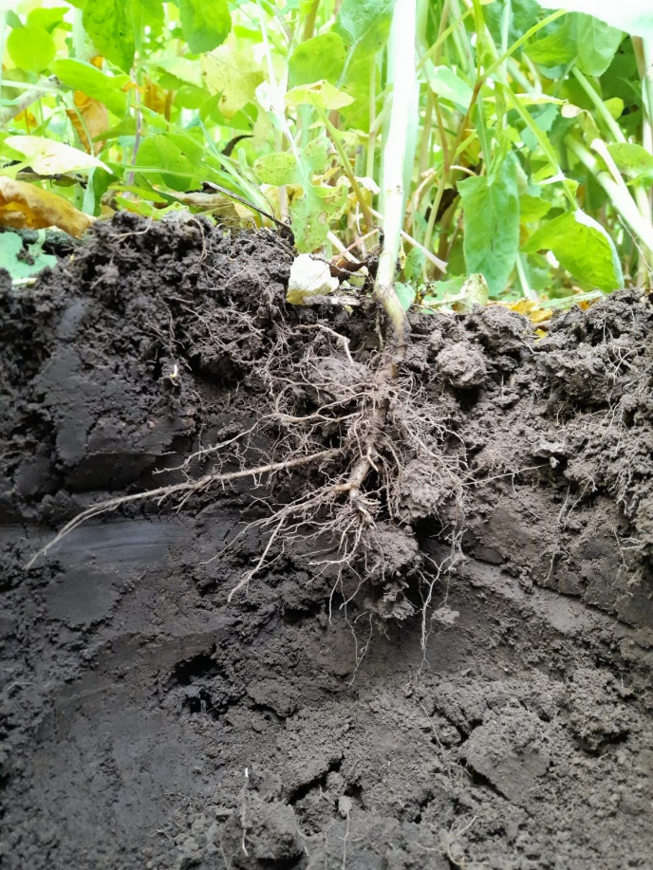
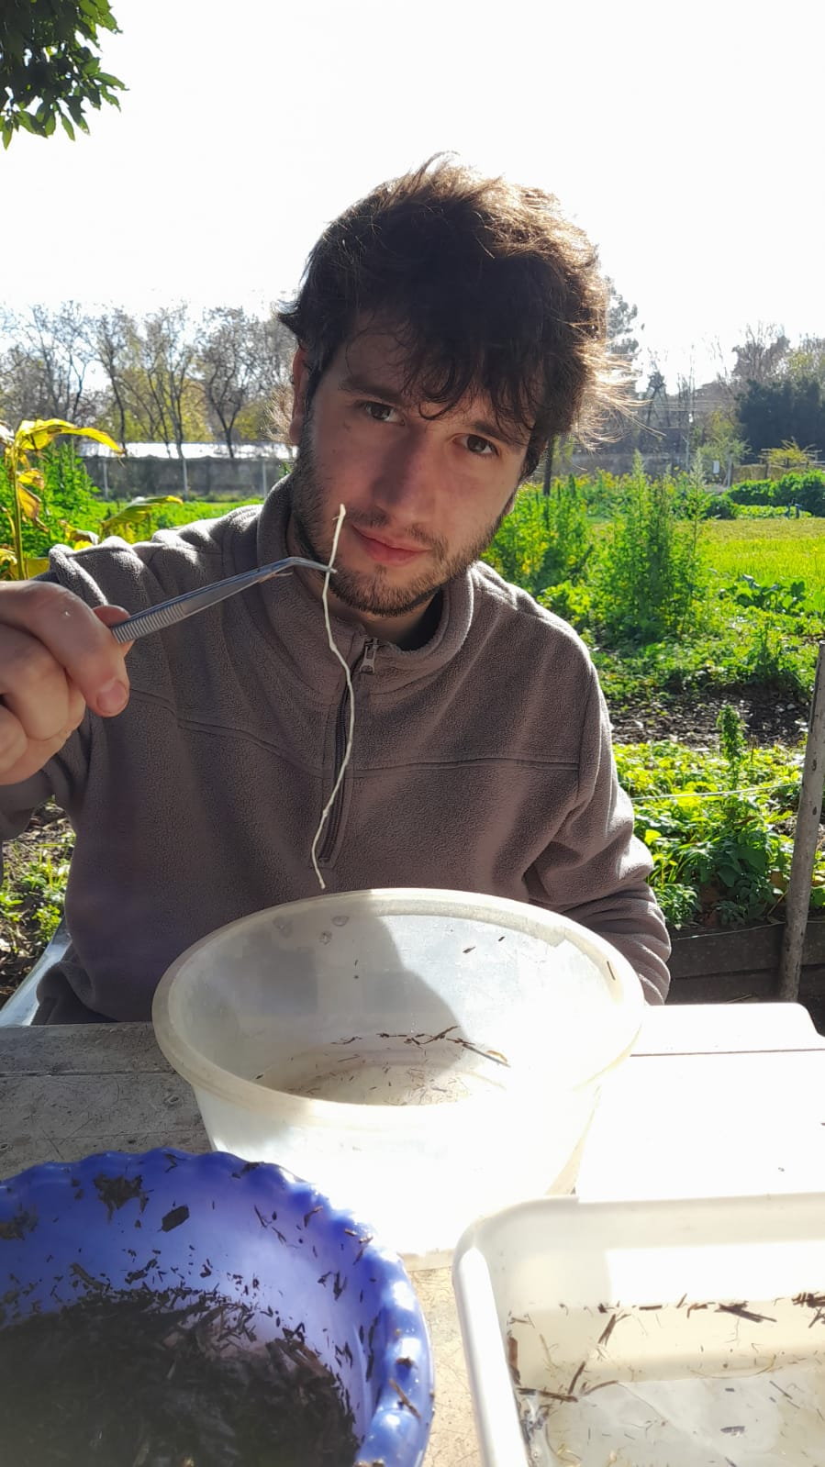
Root sampling
-Five sampling stages: V4-V5 (new), V6-V7, Flowering, grain filling (new), harvest
(the rest coincide with 2021)
-Root washing and scanning with WinRhyzo
-Root dry weight was also recorded
May 4, 2022 (22 DAE) V4-V5
Aug 15, 2022 (125 DAE) Flowering
0-0.2 m
0.2-0.4 m
Area = 0.2 x 0.2 m (row centered) x 0.4 m total deep

Slide 10
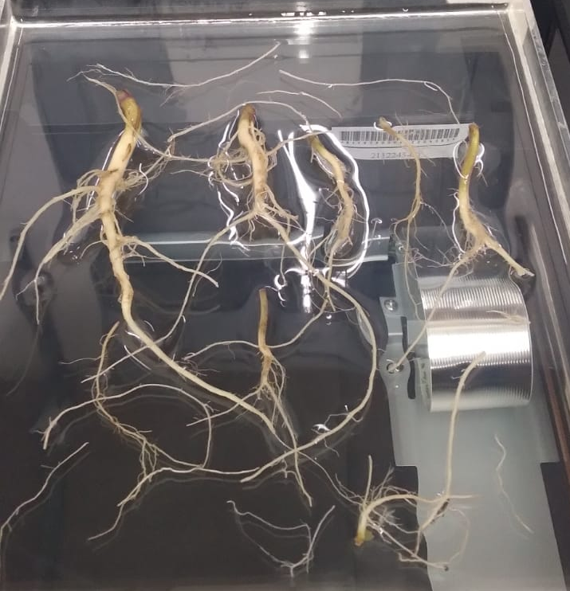
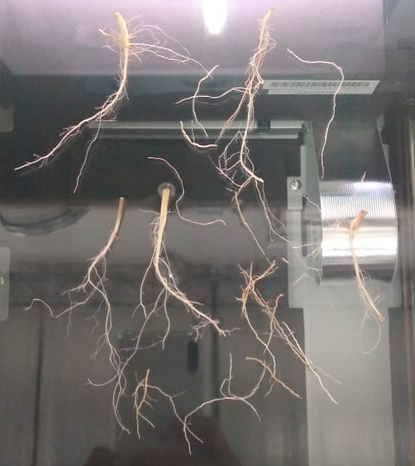
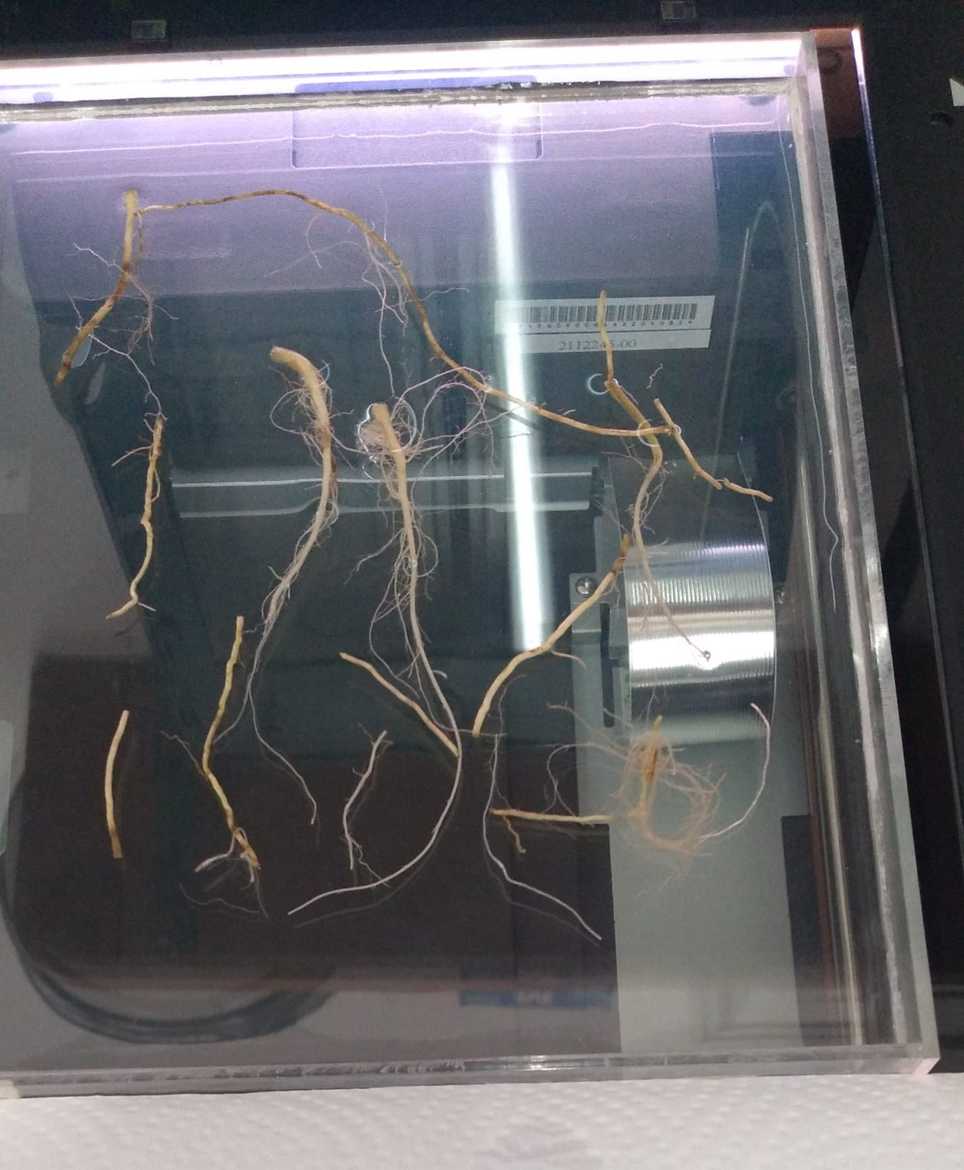
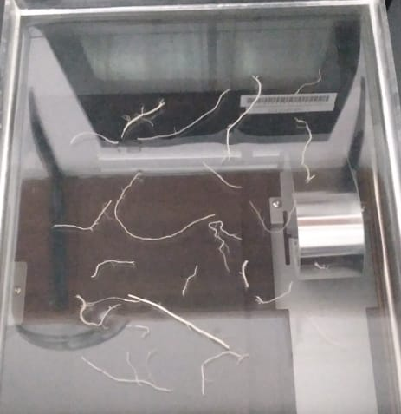
Root Length at V4 and V6
0-0.2 m
May 4, 2022 (22 DAE) Nujet
May 4, 2022 (22 DAE) Avanza
May 26, 2022 (44 DAE) Avanza
0.2-0.4 m
0-0.2 m
0-0.2 m
Roots were analyzed using images taken by the winrhizo scanner

Slide 11
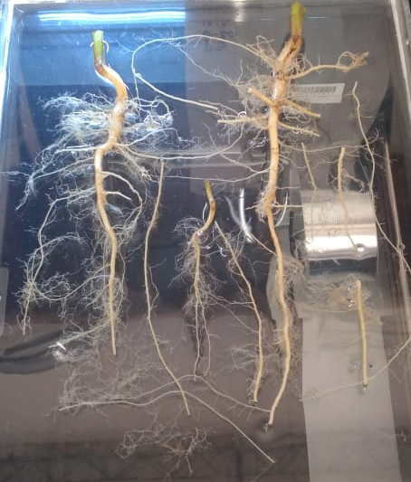
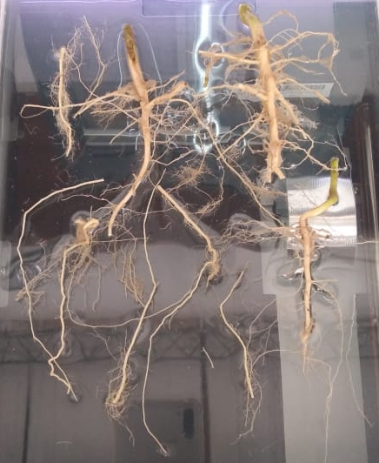
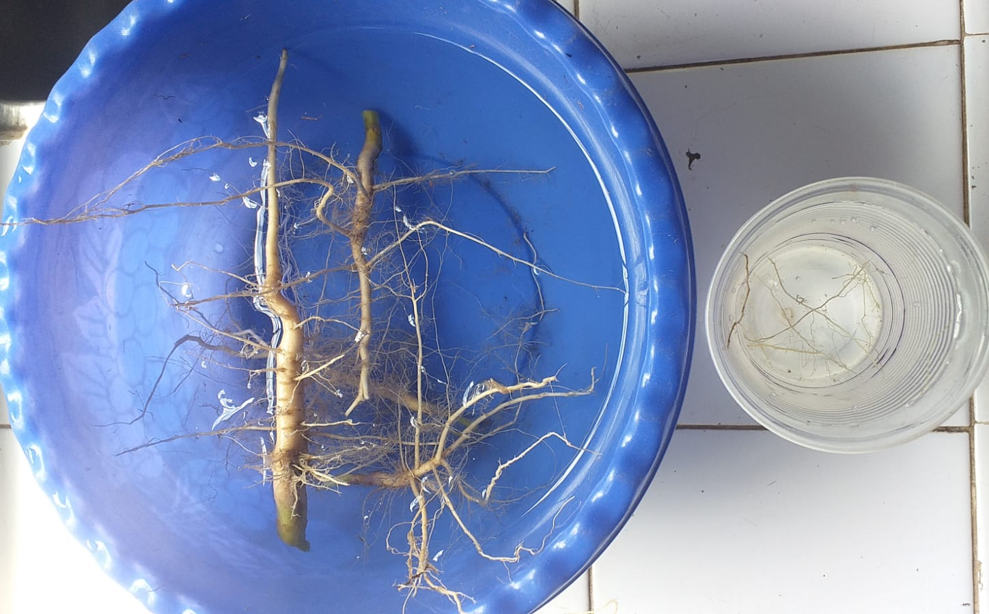
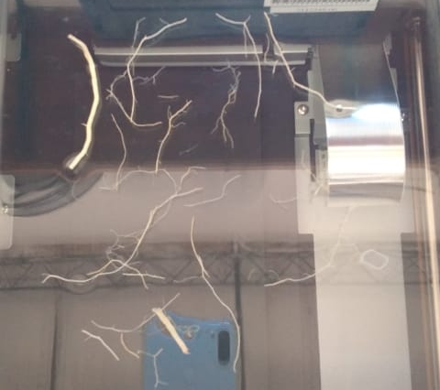
Nujet Aug 15, 2022 Flowering
Avanza Aug 15, 2022 Flowering
Root Length at Flowering, grain filling and maturity
Nujet Sept 19, 2022 Grain-filling
0-0.2 m
0-0.2 m
-Most roots in the top 20 cm
-More roots in the 20-40 cm than in 2021
0-0.2 m
0.2-0.4 m
0.2-0.4 m

Slide 12
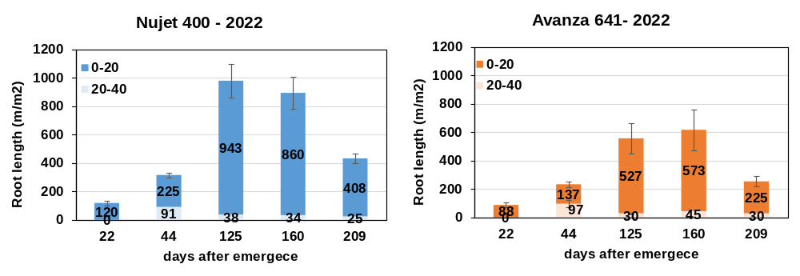
Root Length
V4= 22 DAE V6= 44 DAE FL= 125 DAE Grain-filling = 160 DAE Maturity = 209 DAE
-A complete picture of root development and death (compared to only 3 samplings in 2021)
-At flowering ~ 1 kilometer root per m² (as in 2021 but lower than 2-3 km/m² reported in canola (Zhang et al 2005) AJAR
-Less root length for Avanza 641
-Root length does not increase between flowering and grain filling
-Then, root length was halved at maturity (0.3-0.4 kilometer/m²)

Slide 13
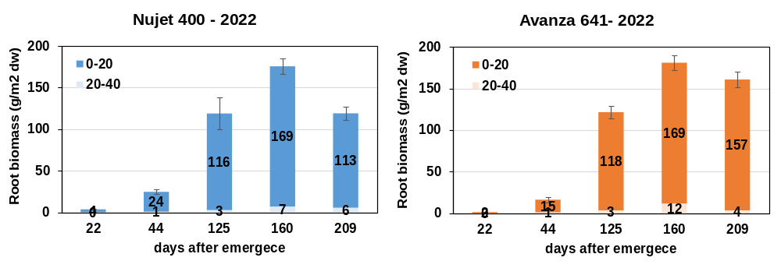
Root Biomass
V4= 22 DAE V6= 44 DAE FL= 125 DAE Grain-filling = 160 DAE Maturity = 209 DAE
-Roots are mainly in the topsoil, with little (but not null) growth beyond 0.4 m (strong Bt clay horizon and drip irrigation)
-At flowering ~1200 kg/ha of dry biomass allocated in roots (equal to 20-25% of aerial biomass). Shoot/root ratio= 4-5
-Root biomass increase by 50% during grain filling period (in contrast to rooth length, and not evaluated in 2021)
-Total root biomass at maturity ~1200-1600 kg/ha. Shoot/root ratio= 8-9
-Total root biomass (120-160 g/m²) is similar to B. carinata in Uruguay (85-140 g/m²) Mazzilli & Ernst (2021) and mustard (50-80 g/m² ) Gan et al (2009) CJPS and within the range for canola (100-160 g/m² ) Zhang et al (2005) AJAR, Gan et al (2009) CJPS, Wu et al (2020) FPS
-Shoot/root ratio at harvest (8-9) is in the range of B. carinata in Bs As 2021 (8-10) and Uruguay (7.5-11) Mazzilli & Ernst (2021)

Slide 14

Radiation use efficiency
Water use efficiency
Waiting for official meteorological data

Slide 15
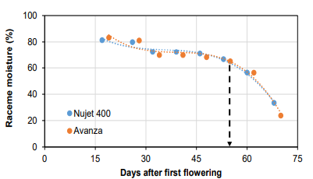
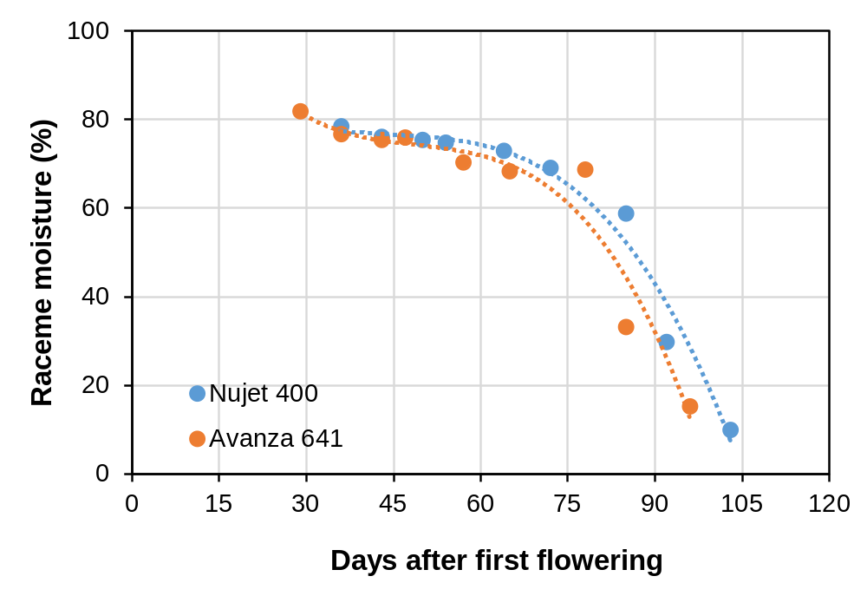

Dynamics of moisture raceme
-Carinata pattern 2022 remarkably similar to 2021 and canola
-Very moist racemes throughout post-flowering
-Fast drying from maturity (from mid Oct onwards)
2021
2022

Slide 16

Crop harvest
November 11, 2022 (213 days after emergence; 219 days after sowing)
For each plot, 3 m (0.6 m² ) from central rows were hand-harvested from different areas in the plot (covering natural plot heterogeneity)
Canopy structure at harvest
Canopy structure | Nujet 400 | Avanza 641 | p-value
Plant height (cm) | 172 ± 5,7 a | 147 ± 4,5 b | 0,0083
Main raceme length (cm) | 32 ± 2,5 | 37 ± 0,8 | 0,1008
Height to the first basal siliques (cm) | 122 ± 4,8 a | 98 ± 4,7 b | 0,0073
Number of primary branches (#/pl) | 7,8 ± 0,7 | 6,8 ± 0,4 | 0,2903
Number of siliques from the main raceme (#/pl) | 19 ± 1,0 a | 17 ± 0,3 b | 0,0316
Nujet 400
Nujet 400 had plants 25 cm taller, with significantly more siliques on the main raceme, and the first basal siliques were located taller in the canopy respect to Avanza 641. Despite the height, they did not lodge
Unlike 2021, branching did not differ significantly between genotypes.
In both, 2021 and 2022, the silique layer expanded by about 40-50 cm.

Slide 17
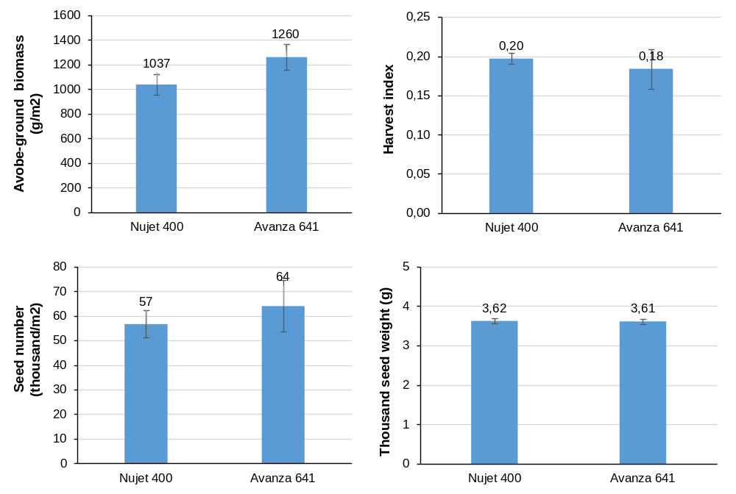
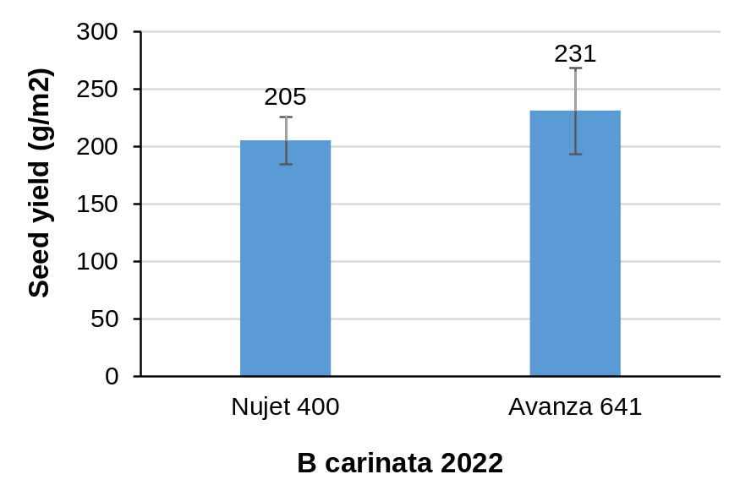
Seed yield and its components
Biomass was dried, weighted, hand-threshed. TSW was calculated from 200-seeds aliquot
2000-2300 kg seed/ha (DW)
Similar in both genotypes
High variability, especially for Avanza
Seed yield did not exceed that of 2021 (2200-2300 kg/ha) despite having 40 more days of cycle
Harvest index was lower (0.18-0.20) than in 2021 (0.24) and USA (0.28-0.37) and Uruguay (0.23-0.34) Seepaul et al. (2021); Mazzilli & Ernst (2020). Flowering at late July-early August doesn’t seem suitable for high productivity in Buenos Aires

Slide 18
Seed composition
Crop productivity
Total biomass corrected by energy cost
Waiting for lab results

Slide 19
Soil organic matter after harvest
-At 15 days after harvest, aerial biomass (straw) was cut with a mechanical mower, remaining on the surface, without tillage.
-At 30 days after harvest, soil was sampled (0-20 m depth) from the middle of each plot and sent to external lab for determining the content of particulated organic matter (newly incorporated organic matter)
Particulated organic matter (%)
Nujet 400 | Avanza 641
0.49 | 0.44
Values are higher than 2021 (0.33-0.26) and they are in line with soils under several years of agriculture (< 0.5%).
The particulated organic matter is a short-term source of N because of the rapid mineralization, and is largely associated with higher yields of crops (Dominguez et al., 2006; Imbellone et al. 2010 INTA; Sainz Rozas et al 2011 IPNI)

Slide 20
Section B
Brassica carinata phenology by sowing dates: Data collection for the construction of the CRONOCARINATA model.
Updated February 2023

Slide 21
Sowing dates: more early dates and genotypes than in 2021
2021
2022
Genotypes | Nujet 400; Avanza 641
Sowing | Dates | Genotypes
SD1 | 3/3/22 | Nujet 400; Avanza 641
SD2 | 17/3/22 | Nujet 400; Avanza 641
SD3 | 1/4/22 | Nujet 400; Avanza 641; E63; E 68; E87
SD4 | 13/4/22 | Nujet 400; Avanza 641; E63; E 68; E87
SD5 | 30/4/22 | Nujet 400; Avanza 641; E63; E 68; E87
SD6 | 11/5/22 | Nujet 400; Avanza 641; E63; E 68; E87
SD7 | 3/6/22 | Nujet 400; Avanza 641; E63; E 68; E87; E93
SD8 | 23/6/22 | Nujet 400; Avanza 641; E63; E 68; E87; E93
SD9 | 16/7/22 | Nujet 400; Avanza 641; E63; E 68; E87; E93
SD10 | 30/7/22 | Nujet 400; Avanza 641; E63; E 68; E87; E93
SD11 | 19/8/22 | Nujet 400; Avanza 641; E63; E 68; E87; E93
Sowing | Dates
SD1 | 12/5/2021
SD2 | 1/6/2021
SD3 | 23/6/2021
SD4 | 16/7/2021
SD5 | 29/7/2021
SD6 | 20/8/2021

Slide 22
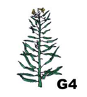







Crop Stages: Sowing, Emergence, vegetative stage of Rosette (4 emerged leaves – V4), Visible Floral Bud, First Flowering, First Fruiting , Green grains, Colored Grains and Maturity, according to CETIOM scale for canola (Arnoud 1989)
Em V4 FB FF FFr Firm Green grain Coloured grain
As mustard seed color is light yellow, ‘coloured grain’ stage is a bit difficult to distinguish
Duration was measured in calendar days and thermal time (degree days - °Cd ) using a base temperature of 0°C
Other authors use Tbase 4-4.5 (Seepaul et al. 2021) but Mazzilli didn’t find differences using 0°C in Uruguay

Slide 23
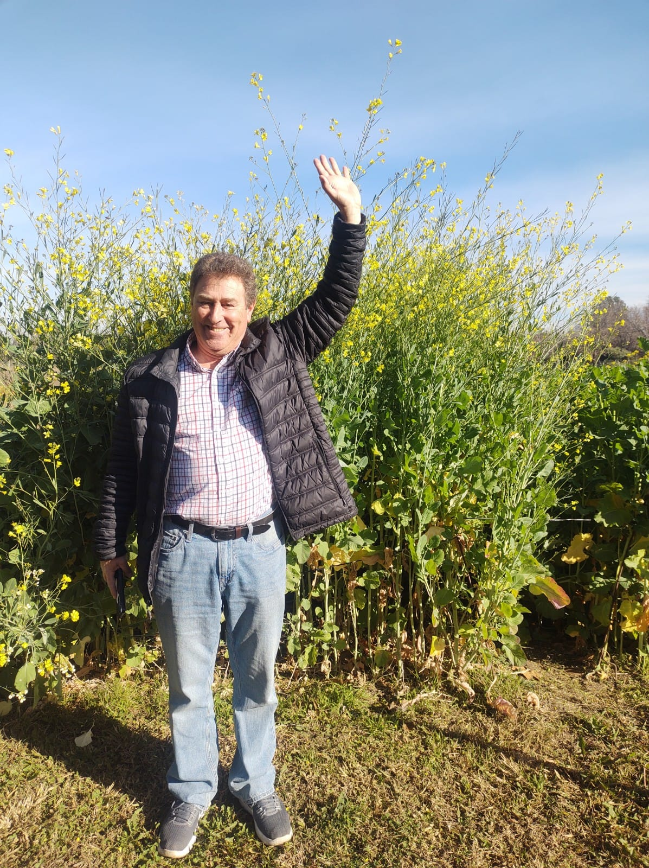
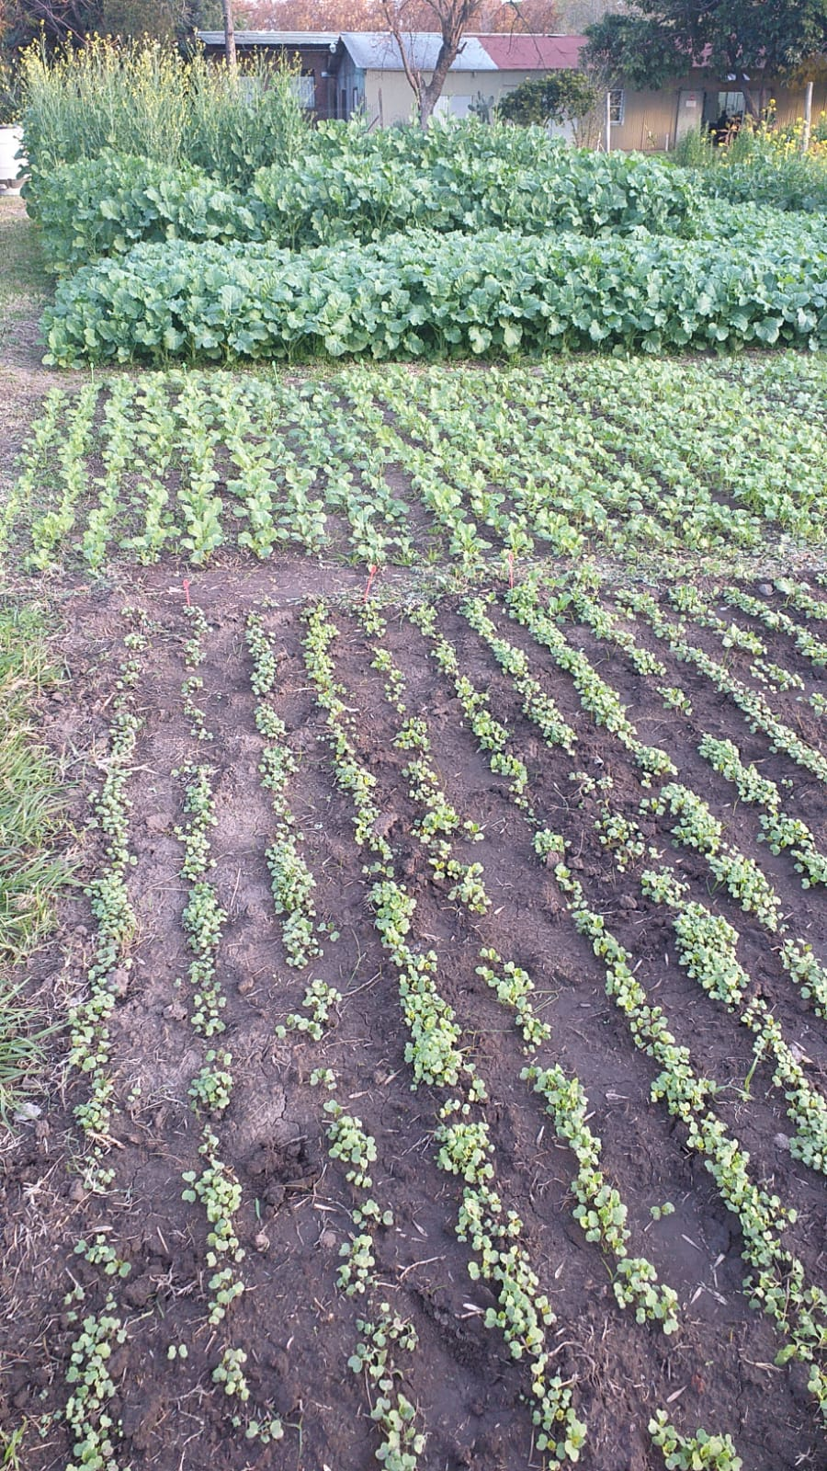

Photo: June 29, 2022
Photo: June 3, 2022
SD1 (March 3) at Fruiting
SD1
Photo: June 29, 2022
SD2
SD3
SD1
SD2
SD4
Very tall plants
SD3
SD4
SD5
SD5
SD6
SD6
SD7
SD8
leaf yellowing
Support to avoid lodging

Slide 24

N
June 27, 2022
Aerial view
Cronocarinata
Carinata biomass
N
Ava
Nuj
Canola panel
SD8 23/6
Ídem 2021
Avanza 641
SD7 3/6
Cover crop (oat)
SD6 11/5
SD5 30/4
SD4 13/4
SD earlier than 2021
Nujet 400
SD3 1/4
SD April 6
(earlier than 2021)
SD2 17/3
SD1 3/3

Slide 25



July 12, 2022
Very tall plants in early SD. Stakes and ties were placed in the plots to prevent lodging
SD1
SD2
SD3
SD2
SD4
SD1
SD2
SD5
SD6
SD7
SD3
E93 SD7
E93 SD8
SD8

Slide 26





Sept 9, 2022
Aug 24, 2022
Oct 7, 2022
SD1 to 4 hidden behind
SD4
SD6
SD9
SD1
SD5
SD7
SD1
SD5
SD3
SD8
SD 3 to SD 7
SD6
E93 SD7
SD 10 E93
SD7
SD 8
SD 9 E93
SD 8 E93
E93 SD7
E93 SD8
E93 SD9
SD 9
SD8
SD 10
Sept 19, 2022
Oct 7, 2022
SD 11
SD 11
SD9
SD 10
SD 10

Slide 27
PHENOLOGY: Data collected during 2022 to build the CRONOCARINATA model
During 2022 growing season 11 sowing dates were carried out at the experimental field of the School of Agriculture University of buenos Aires from early of March to late in August. Sowing dates area detailed as follow: 3 March, 17 March, 1 April, 13 April, 30 April, 11 May, 3 June, 23 June, 16 July, 30 July, and 19 August.
The genotypes included in the analysis were: NUJET, AVANZA, E63, E68, E87 and E93. The genotypes E63, E68 and E87 were included from the 3rd sowing date (1 April) onward and the genotype E93 participated from the 7th sowing ( 3 June) onward due to in all cases the seed arrived later to the University.
In all cases the density was 100 plants/m² and experiments were irrigated and fertilized for avoiding abiotic stress. Fungicides and insecticides were applied to prevent insect and diseases.
Phenological stages recorded were: Sowing, emergence, 4 leaves appeared (Rosset stage), floral visible bud, first flowering, first fruiting, green grains, colored grains, maturity and harvest. In all cases the stage was recorded when 50% of the plants reached each particular stage.
NOTE: At this time (February 2023) all data were collected, and we are waiting for meteodata to build the CRONOCARINATA model

Slide 28

SOWING-EMERGENCE
The period from sowing to emergence measures in days was different depending on the sowing date. In the earliest sowing emergence was ca 5 days, increasing that period up to 12 days in winter sowings and decreasing in the latest sowing dates. Probably measured in Thermal tine the duration would be similar.
 | Nujet | Avanza | E63 | E68 | E87 | E93
Second order polynomial (quadratic)
Best-fit values
B0 | 2,673 | 2,673 | -0,2772 | -0,2772 | -0,2772 | -11,22
B1 | 0,8416 | 0,8416 | 1,308 | 1,308 | 1,308 | 2,191
B2 | -0,02418 | -0,02418 | -0,03950 | -0,03950 | -0,03950 | -0,05690
95% CI (profile likelihood)
B0 | 0,6701 to 4,676 | 0,6701 to 4,676 | -4,242 to 3,688 | -4,242 to 3,688 | -4,242 to 3,688 | -91,47 to 69,02
B1 | 0,4344 to 1,249 | 0,4344 to 1,249 | 0,6502 to 1,967 | 0,6502 to 1,967 | 0,6502 to 1,967 | -6,714 to 11,10
B2 | -0,0405 to -0,007827 | -0,04053 to -0,007827 | -0,06258 to -0,01643 | -0,06258 to -0,01643 | -0,06258 to -0,01643 | -0,2956 to 0,1818
Goodness of Fit
Degrees of Freedom | 8 | 8 | 6 | 6 | 6 | 2
R squared | 0,8441 | 0,8441 | 0,8481 | 0,8481 | 0,8481 | 0,3804
Sum of Squares | 11,31 | 11,31 | 6,108 | 6,108 | 6,108 | 4,957
Sy.x | 1,189 | 1,189 | 1,009 | 1,009 | 1,009 | 1,574

Slide 29

NUJET: The duration of different phenological phases showed a polynomic response when was plotted against the date of emergence. Thus, duration was increased from the earliest to middle sowing dates and for sowing dates from middle May onwards most of the phases were reduced. The latest phase from green grans onwards showed a linear negative trend due to delayed in sowing/emergence dates.
 | V4 | Floral bud | First flowering | First fruiting | Green grains | Colored grains | Maturity
Second order polynomial (quadratic)
Best-fit values
B0 | 15,59 | 62,95 | 83,47 | 114,5 | 177,6 | 209,6 | 230,8
B1 | 2,565 | 3,571 | 4,372 | 2,350 | -2,280 | -3,241 | -4,375
B2 | -0,08715 | -0,1869 | -0,2416 | -0,1900 | -0,05847 | -0,05311 | -0,03765
95% CI (profile likelihood)
B0 | 8,765 to 22,41 | 52,44 to 73,45 | 67,37 to 99,56 | 96,36 to 132,7 | 167,5 to 187,7 | 199,4 to 219,7 | 217,1 to 244,5
B1 | 1,215 to 3,916 | 1,490 to 5,652 | 1,185 to 7,560 | -1,247 to 5,948 | -4,287 to -0,2731 | -5,253 to -1,229 | -7,093 to -1,658
B2 | -0,1400 to -0,03433 | -0,2682 to -0,1055 | -0,3662 to -0,1170 | -0,3307 to -0,04938 | -0,1369 to 0,0199 | -0,1318 to 0,0255 | -0,1439 to 0,0686
Goodness of Fit
Degrees of Freedom | 8 | 8 | 8 | 8 | 8 | 8 | 8
R squared | 0,7318 | 0,8565 | 0,8320 | 0,8431 | 0,9716 | 0,9806 | 0,9740
Sum of Squares | 132,2 | 313,6 | 735,9 | 937,3 | 291,7 | 293,3 | 534,9
Sy.x | 4,065 | 6,261 | 9,591 | 10,82 | 6,038 | 6,055 | 8,177

Slide 30

AVANZA: This genotype showed similar values than NUJET .In both genotypes the largest differences between stages (e.g. from V4 to first flowering was observed in the earliest sowing dates. Similarly, the greatest differences between first flowering and maturity was observed in sowing dates from April to May.
 | V4 | Floral bud | First flowering | First fruiting | Green grains | Colored grains | Maturity
Second order polynomial (quadratic)
Best-fit values
B0 | 15,47 | 62,00 | 83,19 | 114,5 | 176,9 | 209,1 | 230,5
B1 | 2,582 | 3,409 | 4,093 | 2,069 | -2,180 | -3,211 | -4,340
B2 | -0,08838 | -0,1777 | -0,2294 | -0,1752 | -0,06391 | -0,05544 | -0,04018
95% CI (profile likelihood)
B0 | 9,031 to 21,90 | 51,89 to 72,11 | 67,24 to 99,13 | 95,87 to 133,0 | 167,5 to 186,3 | 199,3 to 218,9 | 217,7 to 243,2
B1 | 1,308 to 3,856 | 1,407 to 5,411 | 0,9359 to 7,251 | -1,612 to 5,749 | -4,040 to -0,3198 | -5,154 to -1,269 | -6,872 to -1,808
B2 | -0,1382 to -0,0385 | -0,2560 to -0,09947 | -0,3529 to -0,1060 | -0,3191 to -0,03124 | -0,1367 to 0,00883 | -0,1314 to 0,0205 | -0,1392 to 0,05882
Goodness of Fit
Degrees of Freedom | 8 | 8 | 8 | 8 | 8 | 8 | 8
R squared | 0,7534 | 0,8525 | 0,8254 | 0,8237 | 0,9759 | 0,9821 | 0,9776
Sum of Squares | 117,6 | 290,3 | 722,2 | 981,3 | 250,7 | 273,2 | 464,4
Sy.x | 3,834 | 6,024 | 9,502 | 11,08 | 5,598 | 5,844 | 7,619

Slide 31

E63: This genotype showed similar trend than the other commercial materials (NUJET and AVANZA). However, the differences between phases in the earliest sowings, especially from floral bud to the rest of the phases were lower than the other previous genotypes.
 | V4 | Floral bud | First flowering | First fruiting | Green grains | Colored grains | Maturity
Second order polynomial (quadratic)
Best-fit values
B0 | 6,390 | 77,18 | 111,0 | 149,8 | 188,7 | 214,9 | 249,6
B1 | 3,906 | 1,535 | -0,1638 | -3,327 | -4,061 | -4,063 | -7,140
B2 | -0,1280 | -0,1269 | -0,09300 | -0,002181 | -0,001086 | -0,02843 | 0,04787
95% CI (profile likelihood)
B0 | -9,235 to 22,01 | 64,31 to 90,05 | 94,00 to 128,0 | 131,3 to 168,3 | 173,3 to 204,0 | 187,6 to 242,3 | 221,9 to 277,4
B1 | 1,395 to 6,416 | -0,5329 to 3,603 | -2,894 to 2,566 | -6,300 to -0,3543 | -6,529 to -1,592 | -8,452 to 0,3258 | -11,60 to -2,685
B2 | -0,213 to -0,0425 | -0,197 to -0,0564 | -0,186 to -3,853e-006 | -0,1035 to 0,09909 | -0,0852 to 0,08300 | -0,1779 to 0,1211 | -0,1039 to 0,199
Goodness of Fit
Degrees of Freedom | 6 | 6 | 6 | 6 | 6 | 6 | 6
R squared | 0,7095 | 0,9705 | 0,9694 | 0,9735 | 0,9873 | 0,9722 | 0,9793
Sum of Squares | 94,70 | 64,27 | 112,0 | 132,8 | 91,56 | 289,5 | 298,3
Sy.x | 3,973 | 3,273 | 4,321 | 4,705 | 3,906 | 6,946 | 7,051

Slide 32

E68: This genotype showed similar trend than the other commercial materials (NUJET and AVANZA). However, the differences between phases in the earliest sowings, especially from floral bud to the rest of the phases were lower than the other previous genotypes.
 | V4 | Floral bud | First flowering | First fruiting | Green grains | Colored grains | Maturity
Second order polynomial (quadratic)
Best-fit values
B0 | 3,064 | 75,68 | 113,1 | 155,8 | 190,3 | 215,6 | 249,6
B1 | 4,373 | 1,402 | -0,4213 | -4,177 | -4,266 | -4,268 | -7,164
B2 | -0,1454 | -0,1186 | -0,08716 | 0,02452 | 0,003970 | -0,01804 | 0,04913
95% CI (profile likelihood)
B0 | -11,73 to 17,86 | 62,28 to 89,08 | 96,62 to 129,5 | 140,1 to 171,6 | 176,9 to 203,8 | 188,6 to 242,6 | 222,3 to 276,8
B1 | 1,996 to 6,750 | -0,7500 to 3,555 | -3,065 to 2,223 | -6,702 to -1,651 | -6,426 to -2,106 | -8,600 to 0,06398 | -11,54 to -2,790
B2 | -0,2263 to -0,0644 | -0,1919 to -0,04529 | -0,1772 to 0,00290 | -0,06151 to 0,1105 | -0,0696 to 0,07755 | -0,1656 to 0,1295 | -0,0998 to 0,1981
Goodness of Fit
Degrees of Freedom | 6 | 6 | 6 | 6 | 6 | 6 | 6
R squared | 0,7718 | 0,9648 | 0,9727 | 0,9816 | 0,9905 | 0,9718 | 0,9799
Sum of Squares | 84,90 | 69,62 | 105,1 | 95,84 | 70,11 | 282,0 | 287,4
Sy.x | 3,762 | 3,406 | 4,185 | 3,997 | 3,418 | 6,856 | 6,921

Slide 33

E87: This genotype showed similar trend than E63 and E68. The highest differences was observed in the earliest sowing dates between V4 and the rest of the stages.
 | V4 | Floral bud | First flowering | First fruiting | Green grains | Colored grains | Maturity
Second order polynomial (quadratic)
Best-fit values
B0 | 4,705 | 77,16 | 104,4 | 148,3 | 190,0 | 215,6 | 250,4
B1 | 4,217 | 1,338 | 0,5276 | -2,949 | -4,184 | -4,171 | -7,229
B2 | -0,1417 | -0,1187 | -0,1137 | -0,02065 | 0,001964 | -0,02178 | 0,05141
95% CI (profile likelihood)
B0 | -9,755 to 19,17 | 63,23 to 91,10 | 83,82 to 125,0 | 130,5 to 166,2 | 175,4 to 204,6 | 188,1 to 243,1 | 221,8 to 278,9
B1 | 1,894 to 6,541 | -0,8998 to 3,577 | -2,784 to 3,840 | -5,817 to -0,08057 | -6,526 to -1,843 | -8,596 to 0,2532 | -11,82 to -2,637
B2 | -0,2209 to -0,0626 | -0,1949 to -0,0424 | -0,2265 to -0,00088 | -0,1184 to 0,07706 | -0,07780 to 0,0817 | -0,1725 to 0,1289 | -0,1050 to 0,207
Goodness of Fit
Degrees of Freedom | 6 | 6 | 6 | 6 | 6 | 6 | 6
R squared | 0,7669 | 0,9641 | 0,9534 | 0,9773 | 0,9887 | 0,9708 | 0,9779
Sum of Squares | 81,11 | 75,28 | 164,8 | 123,6 | 82,39 | 294,2 | 316,9
Sy.x | 3,677 | 3,542 | 5,242 | 4,540 | 3,706 | 7,002 | 7,267

Slide 34

E93 This genotype arrived later and did not participate of the all-sowing dates as was sown from the sowing dates corresponding from beginning of June onward. Thus, only was evaluated in 5 sowing dates. One of the curious aspect in the delayed in the duration of the Emergence-V4 phase suggesting vernalization requirements. However, this delay was not observed n the rest of phases.
 | Emergence | V4 | Floral bud | First flowering | First fruiting | Green grains | Colored grains | Maturity
Second order polynomial (quadratic)
Best-fit values
B0 | 41,22 | 73,37 | 137,1 | 152,1 | 230,6 | 212,7 | 299,4 | 354,5
B1 | -4,676 | -3,686 | -5,945 | -5,031 | -13,27 | -7,661 | -15,00 | -20,55
B2 | 0,1676 | 0,07250 | 0,07714 | 0,03254 | 0,2677 | 0,1026 | 0,2817 | 0,4305
95% CI (profile likelihood)
B0 | -541,6 to 624 | -91,43 to 238,2 | 70,76 to 203,3 | -96,82 to 401,0 | -28,12 to 489,4 | -81,70 to 507,1 | 191,0 to 407,8 | 165,3 to 543,7
B1 | -69,3 to 60,00 | -21,97 to 14,60 | -13,30 to 1,412 | -32,65 to 22,59 | -41,99 to 15,44 | -40,33 to 25,01 | -27,02 to -2,967 | -41,55 to 0,4386
B2 | -1,566 to 1,90 | -0,417 to 0,5627 | -0,120 to 0,2743 | -0,7079 to 0,7730 | -0,5021 to 1,037 | -0,773 to 0,9784 | -0,0407 to 0,6042 | -0,1323 to 0,9932
Goodness of Fit
Degrees of Freedom | 2 | 2 | 2 | 2 | 2 | 2 | 2 | 2
R squared | 0,4364 | 0,7884 | 0,9953 | 0,9582 | 0,9450 | 0,9436 | 0,9944 | 0,9841
Sum of Squares | 261,5 | 20,91 | 3,383 | 47,69 | 51,54 | 66,73 | 9,044 | 27,55
Sy.x | 11,43 | 3,233 | 1,301 | 4,883 | 5,077 | 5,776 | 2,126 | 3,711

Slide 35

COMPARISON AMONG GENOTYPES
 | AVANZA | E63 | E68 | E87 | E93
Best-fit values
Slope | 0,9662 | 0,9517 | 0,9799 | 0,9281 | 1,157
Y-intercept | 1,813 | 3,072 | 0,5229 | 3,231 | -11,36
X-intercept | -1,876 | -3,227 | -0,5337 | -3,481 | 9,825
1/slope | 1,035 | 1,051 | 1,021 | 1,077 | 0,8646
Std. Error
Slope | 0,03486 | 0,03135 | 0,01682 | 0,05643 | 0,1113
Y-intercept | 3,071 | 2,796 | 1,500 | 5,033 | 7,921
95% Confidence Intervals
Slope | 0,8873 to 1,045 | 0,8776 to 1,026 | 0,9401 to 1,020 | 0,7947 to 1,062 | 0,8025 to 1,511
Y-intercept | -5,135 to 8,760 | -3,541 to 9,684 | -3,024 to 4,070 | -8,671 to 15,13 | -36,57 to 13,84
X-intercept | -9,852 to 4,924 | -11,01 to 3,459 | -4,324 to 2,969 | -18,97 to 8,201 | -17,15 to 24,35
Goodness of Fit
R square | 0,9884 | 0,9925 | 0,9979 | 0,9748 | 0,9730
Sy.x | 2,307 | 1,984 | 1,064 | 3,572 | 3,206
Is slope significantly non-zero?
F | 768,2 | 921,7 | 3395 | 270,5 | 108,0
DFn, DFd | 1, 9 | 1, 7 | 1, 7 | 1, 7 | 1, 3
P value | <0,0001 | <0,0001 | <0,0001 | <0,0001 | 0,0019
Deviation from zero? | Significant | Significant | Significant | Significant | Significant
Equation | Y = 0,9662*X + 1,813 | Y = 0,9517*X + 3,072 | Y = 0,9799*X + 0,5229 | Y = 0,9281*X + 3,231 | Y = 1,157*X - 11,36
The occurrence of first flowering duration was compared considered NUJET as a reference genotype. In general, except for the E93 genotype (where the number of data was lower than the others – See above the reasons) in which the slope was higher than 1 (i.e. was earlier at first flowering than the rest). In the rest of the genotypes the slopes were lower than 1 without significant differences in the intercept values (see confidence interval).

Slide 36


COMPARISON FOR V4 AND FIRST FLOWERING STAGES AGAINST NUJET
The differences in the occurrence of V4 and first flowering were compared using as a refences Nujet. In the case of V4 Avanza, E68 and E87 showed in all sowing dates similar or shorter durations than Nujet (Differences were from 0 to 3 days shorter). E63 and E93 were longer of shorter than Nujet depending on the sowing date.
For First flowering, Avanza and E93 showed shorter or longer duration than Nujet (±5 days) depending on the sowing date. The rest of the genotypes showed null or shorter duration up to 7 days respect to Nujet.

Slide 37

DIFERENCES BETWEEN V4 AND FIRST FLOWERING
Differences between V4 (Rosset) and first flowering stage range from 20 to 90 days. The differences started in 50 days in the earliest sowings and increased up to beginning of April reaching differences of ca. 90 days between both stages. From the middle of April differences were reduced up to middle of July (30 days).
The rate of reduction from V4 to First flowering was similar in all genotypes i.e. around 3 days per day of delayed in sowing date from April to August. That rate ranged from -2,83 (E93) to -3,19 (E68).
6 Days/day
-3 Days/day

Slide 38
Parameters of the polynomic adjust of the differences between first flowering and V4 stages against the sowing date
 | NUJET | AVANZA | E63 | E68 | E87
Third order polynomial (cubic)
Best-fit values
B0 | 56,09 | 56,08 | 95,97 | 103,2 | 81,26
B1 | 9,537 | 9,115 | -1,577 | -2,854 | 1,704
B2 | -1,033 | -1,004 | -0,1972 | -0,1300 | -0,4368
B3 | 0,02462 | 0,02419 | 0,005982 | 0,004989 | 0,01145
95% CI (profile likelihood)
B0 | 43,66 to 68,51 | 42,33 to 69,83 | 56,30 to 135,6 | 78,20 to 128,1 | 44,40 to 118,1
B1 | 4,815 to 14,26 | 3,890 to 14,34 | -12,33 to 9,174 | -9,621 to 3,912 | -8,286 to 11,69
B2 | -1,507 to -0,5590 | -1,529 to -0,4798 | -1,037 to 0,6428 | -0,6587 to 0,3986 | -1,217 to 0,3437
B3 | 0,01156 to 0,03767 | 0,009748 to 0,03864 | -0,01373 to 0,02569 | -0,007417 to 0,01740 | -0,006869 to 0,02976
Goodness of Fit
Degrees of Freedom | 7 | 7 | 5 | 5 | 5
R squared | 0,9424 | 0,9264 | 0,9744 | 0,9901 | 0,9753
Sum of Squares | 262,6 | 321,6 | 104,8 | 41,52 | 90,49
Sy.x | 6,125 | 6,778 | 4,578 | 2,882 | 4,254
Number of points
# of X values | 11 | 11 | 11 | 11 | 11
# Y values analyzed | 11 | 11 | 9 | 9 | 9

Slide 39

GRAIN FILLING PERIOD: FLOWERING TO MATURITY
The period from first flowering to maturity was reduced as sowing date was delayed. The rate of reduction was from -4,9 days/day of delayed in sowing date (Nujet, Avanza) to -2,4 Days/day (E93). The rest of the genotypes showed intermediate values
 | NUJET | AVANZA | E63 | E68 | E87 | E93
Best-fit values
Slope | -4,916 | -4,913 | -3,837 | -3,795 | -4,144 | -2,411
Y-intercept | 135,6 | 136,4 | 122,7 | 121,8 | 127,9 | 97,26
X-intercept | 27,58 | 27,77 | 31,98 | 32,10 | 30,86 | 40,33
1/slope | -0,2034 | -0,2035 | -0,2606 | -0,2635 | -0,2413 | -0,4147

Slide 40

GRAIN FILLING PERIOD: FLOWERING TO MATURITY
A negative relationship was also found when the duration of the period from first flowering to maturity was plotted against the time of first flowering. Thus, that period as reduced from 3 to 6 day per day of delay in flowering time. The lowest reduction was observed E93 (ca -4 day/day) and he highest in E63, E68 and E87 with ca -6 day/day. Nujet and Avanza showed values of -5 day/day.
 | NUJET | AVANZA | E63 | E68 | E87 | E93
Best-fit values
Slope | -5,164 | -5,173 | -5,775 | -5,793 | -5,787 | -3,393
Y-intercept | 157,3 | 157,6 | 167,7 | 167,9 | 168,2 | 121,0
X-intercept | 30,45 | 30,47 | 29,04 | 28,98 | 29,06 | 35,65
1/slope | -0,1936 | -0,1933 | -0,1732 | -0,1726 | -0,1728 | -0,2947

Slide 41




Thanks for inspiring and supporting this work
Teamwork: Daniel Miralles, Gonzalo Rivelli, Carina Ibañez, Maximiliano Rodriguez, Gabriela Abeledo, Déborah Rondanini
miralles@agro.uba.ar, rondanin@agro.uba.ar

